Slide 1

APLC
Adidas tech sportS: “The dribbler”

Slide 2

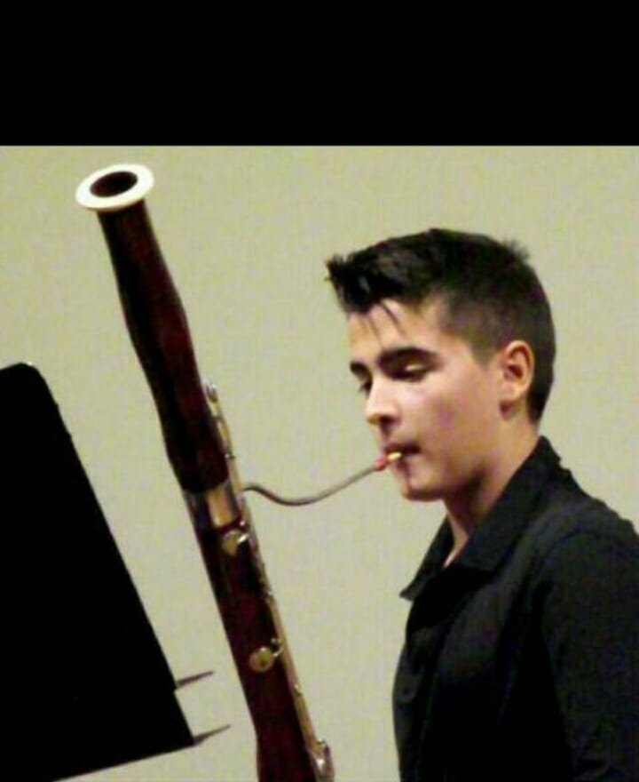
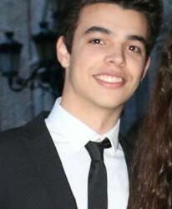
Team members
Jorge serrano ibáñez
1º ingeniería informática
Tomás Pelayo benedet
1º ingeniería informática
Jorge romanos pajares
1º ingeniería informática

Slide 3
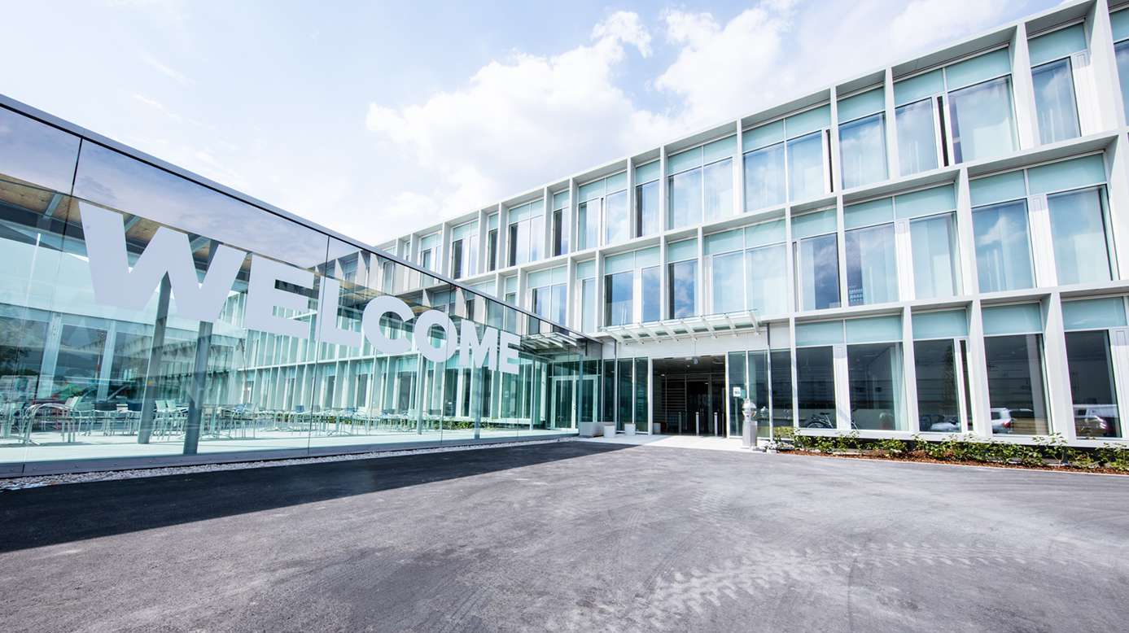
AGENDA
THE STORY
FOCUS
VALUE
DEMO
Q&A

Slide 4
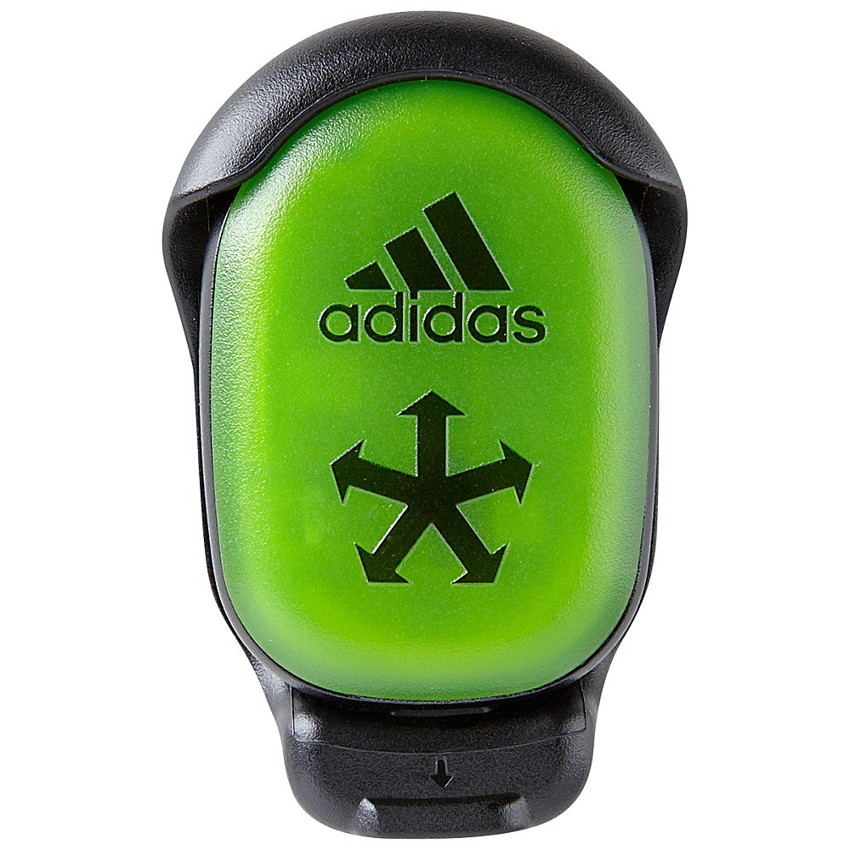
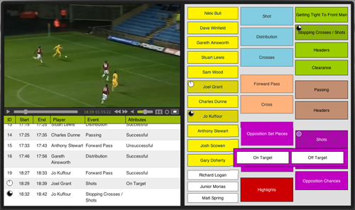

THE STORY - MAKE IT RELATABLE
Introduction – What is the setting

Slide 5


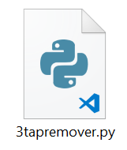
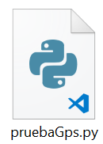
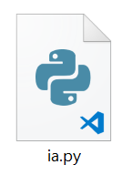
THE STORY - MAKE IT RELATABLE
2. Rising Action – What is happening

Slide 6

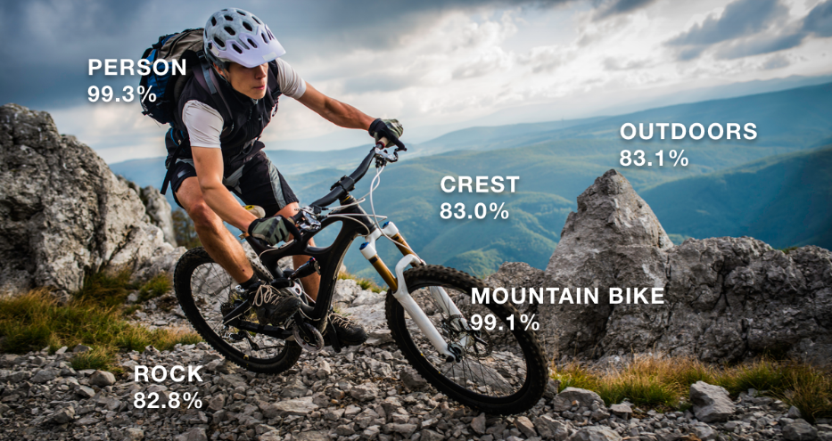
THE STORY - MAKE IT RELATABLE
3. Turning point – Where does it become actionable

Slide 7
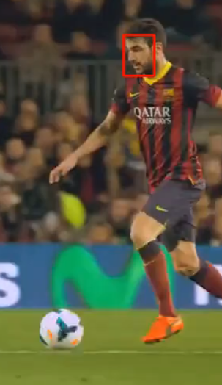
THE STORY - MAKE IT RELATABLE
4. Falling Action – What is the outcome
- Player detection
- Object and player tracking

Slide 8
THE STORY - MAKE IT RELATABLE
5. Resolution – How it will end
A final program in which all data is connected and intelligence is capable of classification and
organization of different football moves. This allows us to STOP MANUAL ANALYTICS.

Slide 9
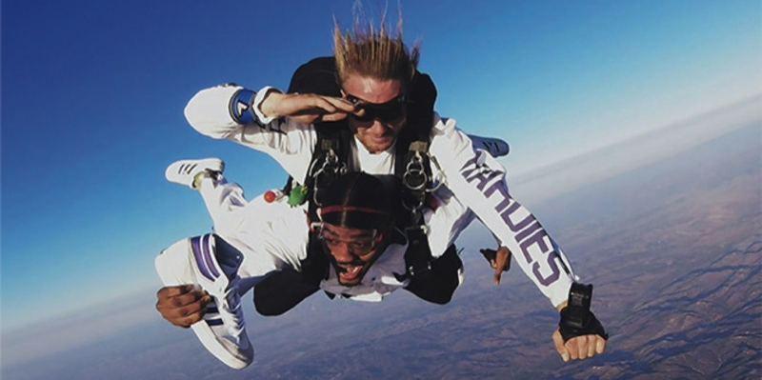
THE STORY

Slide 10
MAKE IT REAL
DEMO

Slide 11
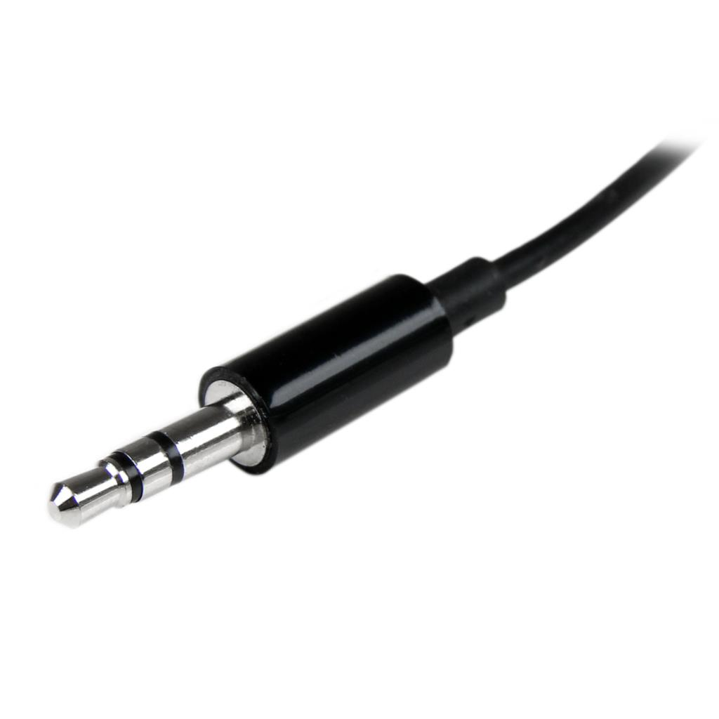
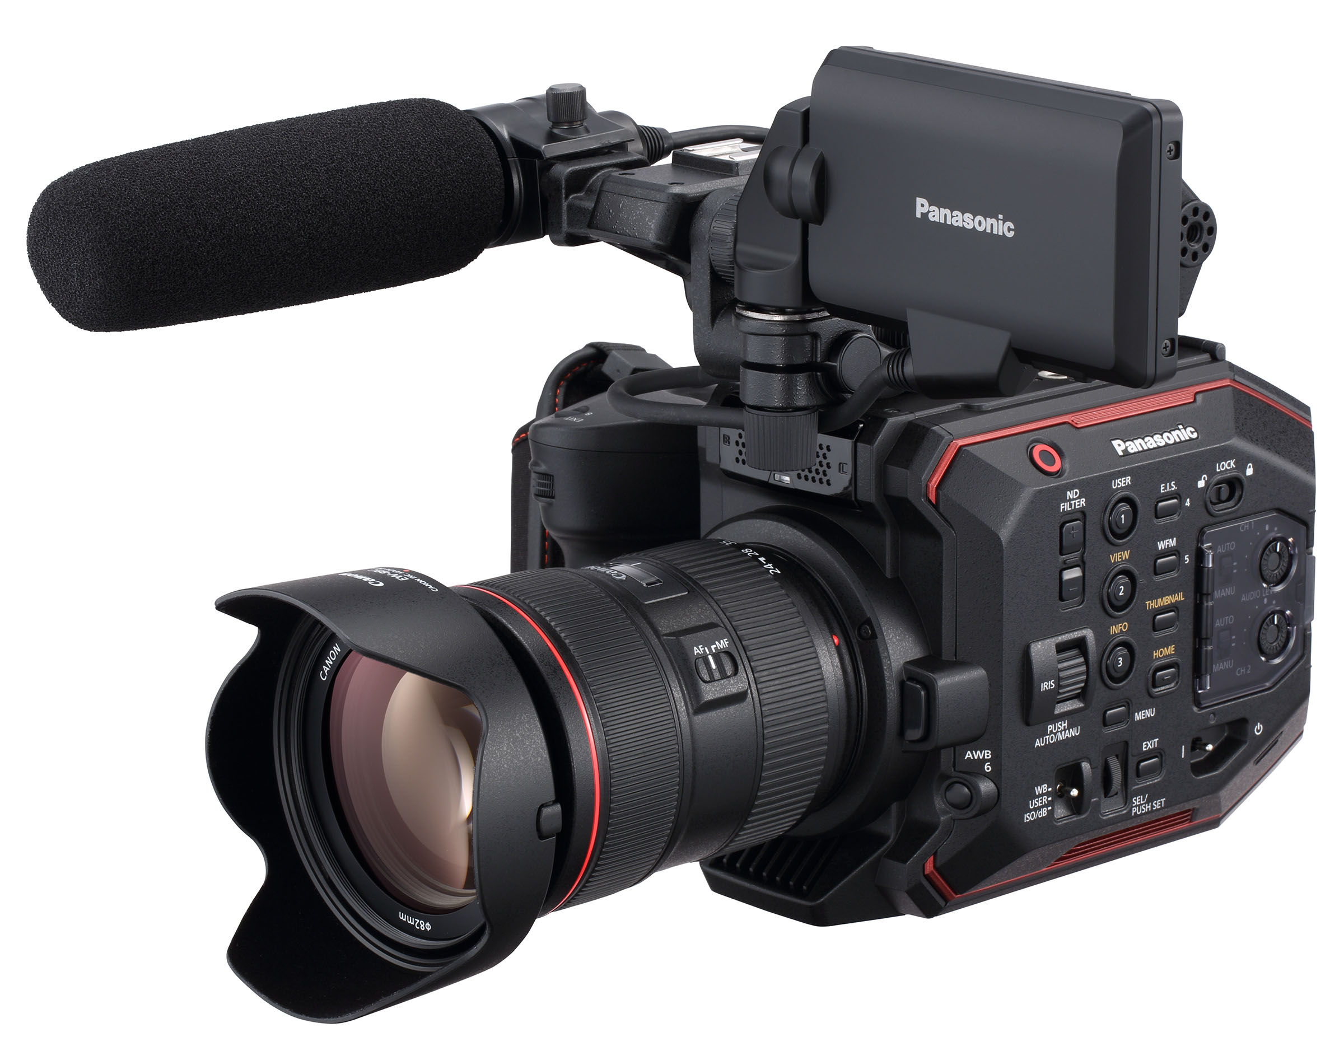
- Easier and cheap sync between sensors and cameras - Easier to develop scripts to sync sensors
HACK-JACK

Slide 12
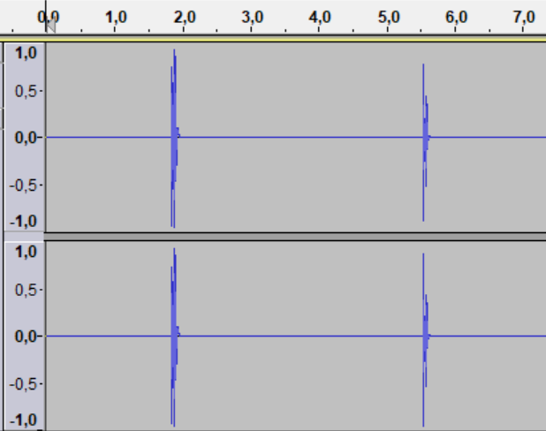
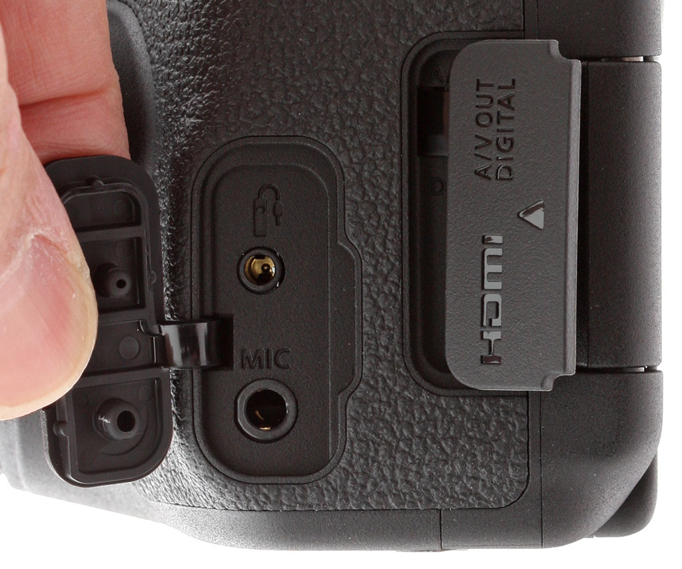
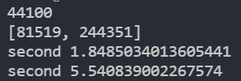

Slide 13
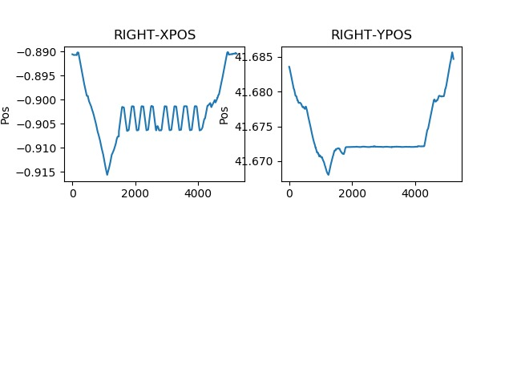
- Analyze player and soccer ball movement - Gathers biometric data at the begining of the training
The dribbler

Slide 14
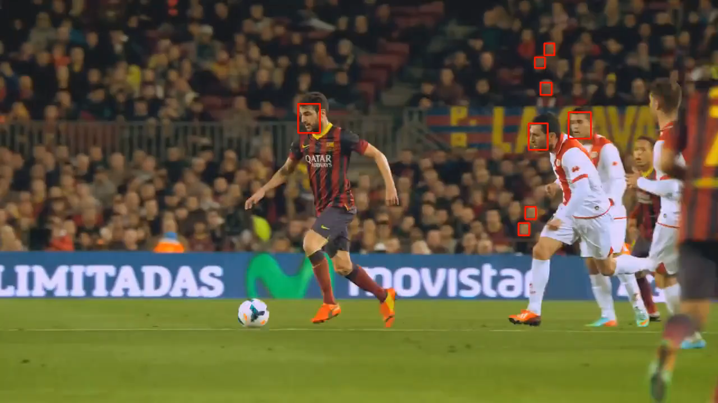

Slide 15
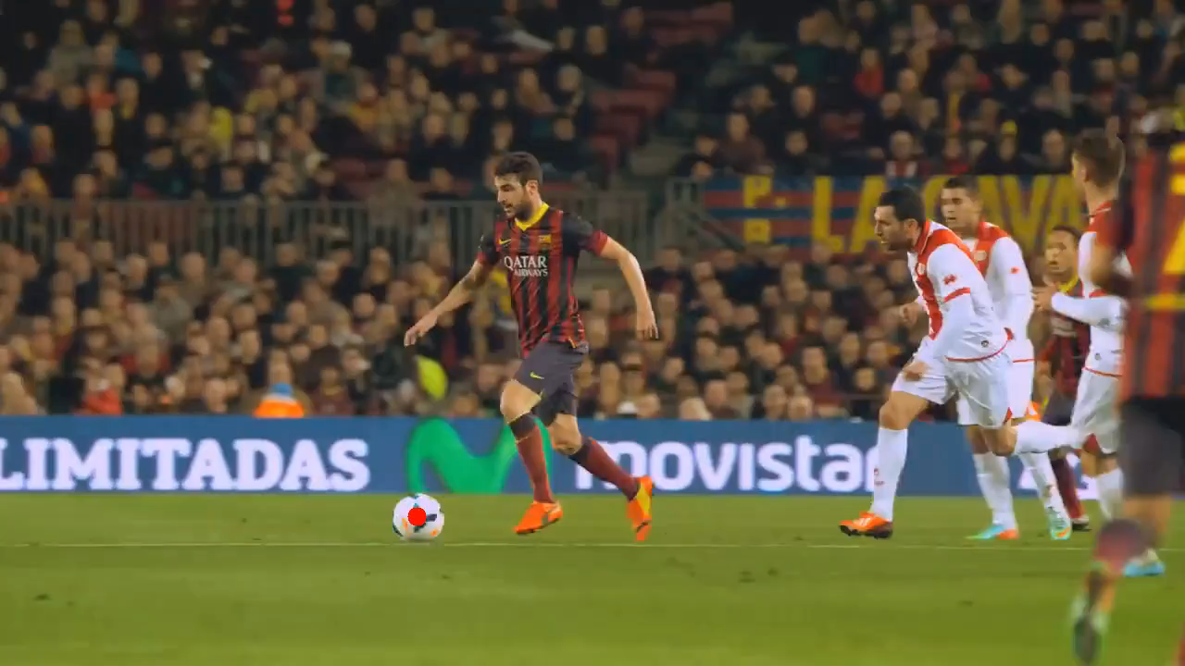

Slide 16

Q
A
&

Slide 17
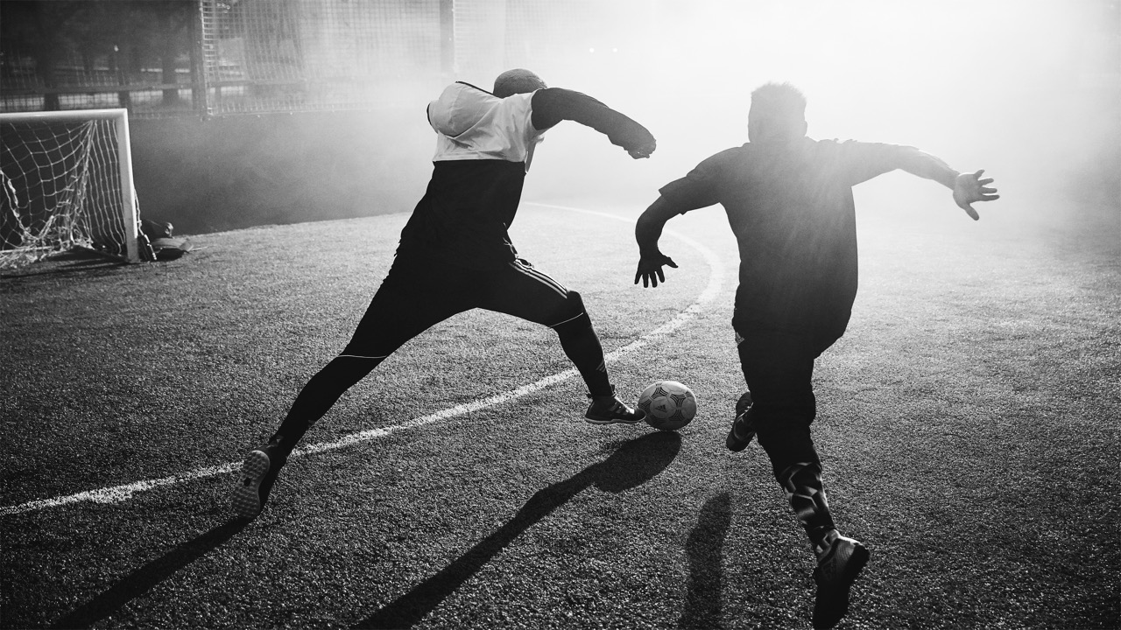
THANK YOU!

